Slide 1


Subset Selection
& MACHINE LEARNING

Slide 2

1.
3.
Defining Subset Selection
Subset Selection Process
Features
Importance
Goals
Benefits
2.
Methods
`Relevance
4.
Needs for Subset Selection
Methods of Attribute Selection
Why we need subsets
Examples
StepWise
Forward & Backward Elimination
Decision Tree
Additional Methods
5.
Factors Affecting Feature Selection
Feature Relevance
Feature Redundancy
Table of Contents

Slide 3
6.
8.
Linear Regression Model
Advantages & Disadvantages
Features
Importance
Goals
Benefits
7.
Methods
`Relevance
9.
Evaluation
Metrics
Live Examples
Why we need subsets
Examples
F1
Area Under the Curve
Considerations
10.
Robustness & Stability
Robustness in Subset
Enhancing Approaches
Future Selection
Table of Contents

Slide 4




What is Subset Selection
Subset selection involves choosing the most impactful features from a larger pool for model building.
It improves model accuracy by focusing on relevant features and reducing noise.
Leads to faster training times due to reduced computational complexity.
Interpretability is enhanced with fewer features, making the model easier to understand.
Integration
Subset selection can be a pre-processing step or incorporated within the learning algorithm.
Some algorithms like decision trees and Lasso regression perform inherent feature selection.
Benefits:
Reduces overfitting: Less prone to fitting to noise in the training data.
Improves generalization: Performs better on unseen data.
Reduces training time: Particularly beneficial for large datasets.
Enhances interpretability: Easier to understand the model's decision-making process.

Slide 5

Need for Subset Selection
Boost Performance & Efficiency
Less is more: Focus on key features, ditch irrelevant noise.
Accuracy & Speed: Models train faster, predict better with the right features.
Subset Selection
Combat Overfitting & Explainability
Avoid memorizing noise: Simpler models generalize better and are easier to understand.
Transparency: Fewer features make model decisions clear and interpretable.
Subset selection is your key to building powerful, interpretable, and resource-friendly machine learning models.
Conquer High Dimensionality & Resources
Tame the data beast: Select crucial features in massive datasets.
Save time & money: Train models faster on less data, deploy efficiently.

Slide 6

Subset Selection Process
1. Define the Objective:
Clearly define the objective of subset selection. It could be to improve model performance, reduce dimensionality, or enhance interpretability.
2. Generate Subsets:
Create different subsets of features from the original set. This can be done in various ways, including exhaustive search, greedy algorithms, or other heuristic methods.
3. Evaluation Metric:
Choose an evaluation metric to measure the performance of each subset. Common metrics include accuracy, precision, recall, F1-score, or any other relevant metric depending on the specific problem.
4. Evaluate Subsets:
Use a validation set or cross-validation to evaluate the performance of the model using each subset of features. This involves training the model on the selected subset and assessing its performance on a separate dataset not used during training.
5. Select the Best Subset:
Choose the subset that performs the best according to the chosen evaluation metric. This subset will be the final set of features used in the model.
6. Model Training:
Train the final model using the selected subset of features on the entire dataset. This ensures that the model is optimized using the chosen features.
7. Validate the Model:
Validate the model on an independent test set to assess its generalization performance. This step helps ensure that the model is not overfitting to the training data and can make accurate predictions on new, unseen data.

Slide 7
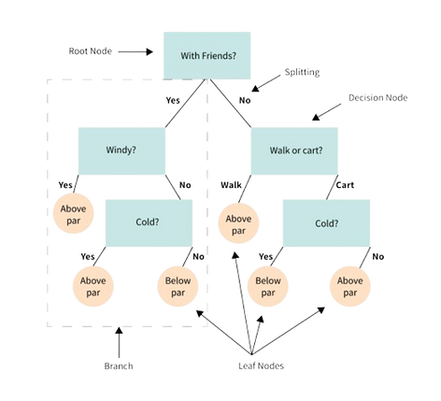
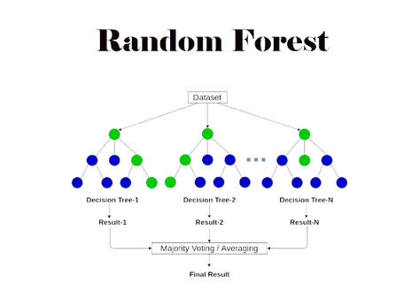
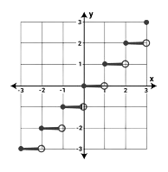
Methods & Attributes
Key Methods:
Stepwise Forward Selection: Starts empty, adds best features one by one.
Stepwise Backward Elimination: Starts with all features, removes least important ones iteratively.
Combination: Combines forward selection and backward elimination for a more robust approach.
Induction: Analyzes tree splits to identify the most important features.
Bonus Techniques
Regularization Methods: Lasso shrinks coefficients, potentially removing features.
Random Forest Feature Importance: Ranks features based on their impact on impurity reduction.
Genetic Algorithms: Evolves feature subsets for optimal performance and complexity.

Slide 8

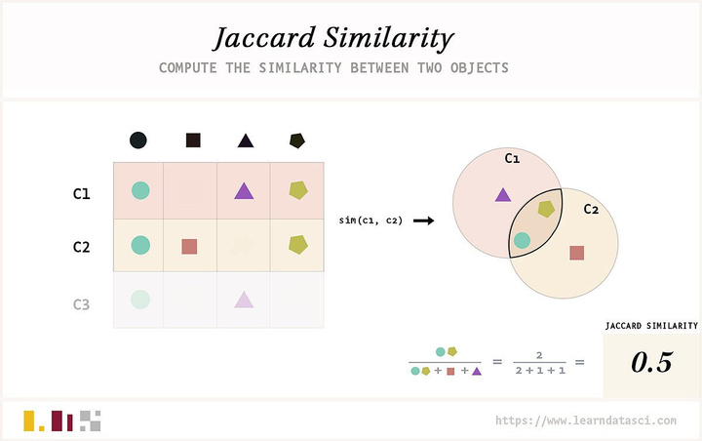
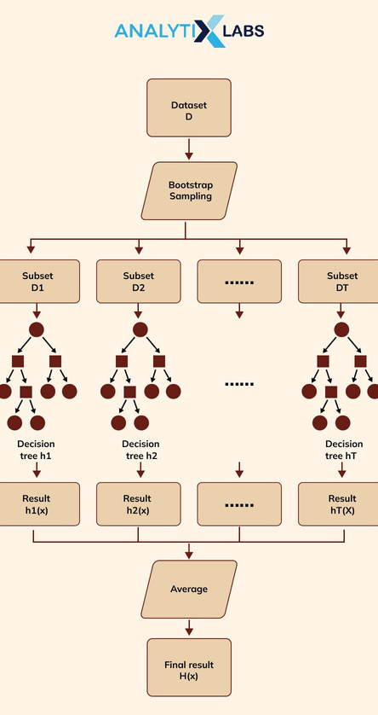
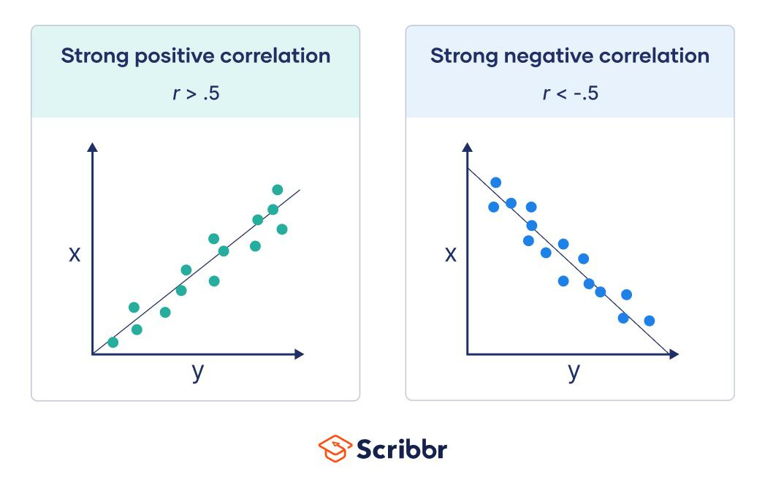
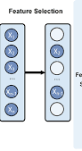
Factors Affecting Feature Selection
Feature Relevance
Significance of a feature in predicting the target variable.
Types:
Strong relevance: Direct impact on the target variable.
Weak relevance: Contributes but less influential.
Conditional relevance: Relevance in specific conditions.
Measuring relevance:
Correlation analysis (Pearson, Spearman).
Mutual information and information gain.
Feature importance metrics (Random Forest, Gradient Boosting).
Feature Redundancy
Occurs when features provide overlapping information.
Measures:
Correlation-Based Similarity Measure: Pearson’s correlation coefficient.
Distance-Based Similarity Measure: Euclidean and Minkowski distances.
Jaccard Index/Coefficient: For binary features.
Cosine Similarity: Measures angle between vectors in multi-dimensional space

Slide 9





diagram
Linear Regression Model
Forward Selection
Model
1. Forward Selection in Linear Regression:
Start with an empty model and add one predictor at a time.
At each step, select the predictor that improves the model fit the most.
Continue adding predictors until a stopping criterion is met.
2. Backward Elimination in Linear Regression:
Start with a model that includes all predictors.
At each step, remove the predictor that contributes the least to the model.
Continue removing predictors until a stopping criterion is met.
3. Stepwise Selection in Linear Regression:
A combination of forward selection and backward elimination.
Start with no predictors in the model.
At each step, evaluate the impact of adding or removing a predictor and choose the option that improves the model fit the most.
Continue until a stopping criterion is met.
Backward Elimination Medel
Stepwise
Selection

Slide 10

Advantages
Dimensionality Reduction:
Subset selection helps in reducing the number of features or variables considered in a model. By focusing on a subset of relevant features, dimensionality reduction simplifies the modeling process, making it computationally more efficient and less prone to overfitting.
Model Interpretability & Generalization: Selecting a subset of the most relevant features contributes to a more interpretable model.
Researchers and practitioners can gain insights into the relationship between the selected features and the target variable, facilitating a better understanding of the underlying patterns in the data.
Computational Efficiency:
Working with a reduced set of features enhances computational efficiency. Training and evaluating models with a smaller feature set result in faster computation times, making subset selection particularly valuable for large datasets and real-time applications.

Slide 11

Disadvantages
Information Loss
Sensitivity to Model and Data Characteristics
Increased Model Bias
Computational Complexity:
Task Dependency:
Optimality Challenges:
Dependence on Feature Selection Criterion:
Task Dependency: Identifying the most suitable subset selection method for a given task may require experimentation and may not have a one-size-fits-all solution.
Optimality Challenges: Achieving the globally optimal subset may be impractical, leading to the adoption of heuristic or approximation methods that might not guarantee the best possible solution.
Dependence on Feature Selection Criterion: The lack of a universally superior criterion can make it challenging to determine the most appropriate feature selection metric for a given task.

Slide 12
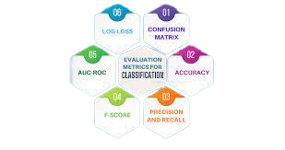
Evaluation Metrics
Precision & Recall: Precision measures the proportion of true positive predictions while recall (also known as sensitivity) quantifies the proportion of true positive predictions out of all actual positive instances in the dataset.
F1-Score: mean of precision and recall, providing a single metric that balances the trade-off between these two measures.
AUC - ROC (Area Under the Receiver Operating Characteristic Curve: graphical representation of the trade-off between true positive rate (TPR) and false positive rate (FPR) across different threshold values for binary classification models.
AUC - PR (Area under the Precision-Recall Curve): plots precision against recall for different threshold values, providing a comprehensive view of the trade-offs between these two metrics.
Considerations
Dataset Characteristics: The distribution of the target variable and the class imbalance within the dataset significantly influence the choice of evaluation metrics.
Use: Precision, Recall, AUC_PR
2. Task Objectives:
The specific objectives of the machine learning task also play a pivotal role in determining the most appropriate evaluation metrics for subset selection.

Slide 13
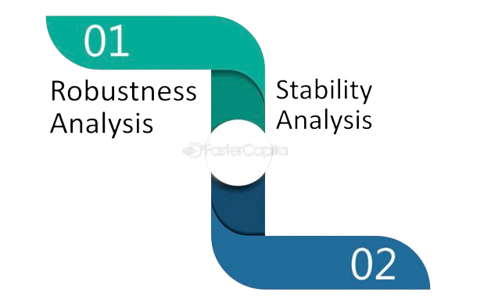
Robustness
The ability of an algorithm to maintain its performance and consistency across different datasets or under various perturbations. In the context of machine learning, robust feature selection algorithms should be able to identify relevant features accurately and consistently, even when the input data exhibit noise, outliers, or variations in distribution.
Regularization Techniques: L1, L2
Stability Selection
Robust Loss Functions: Huber Loss
Stability
Stability in subset selection refers to the consistency of feature selection results across different samples or perturbations of the data. A stable subset selection algorithm should yield consistent feature subsets when applied to similar datasets, thereby instilling confidence in the relevance and reliability of the selected features.
Resampling Techniques: Cross validation, Bootstrapping
Ensemble Methods: Random, SubSpace Methods
Stability Selection Scores

Slide 14
Q and A
ASK AWAY!

